Slide 1




Mule to Spring Boot Migration
Automated Migration Approach & Implementation

Slide 2


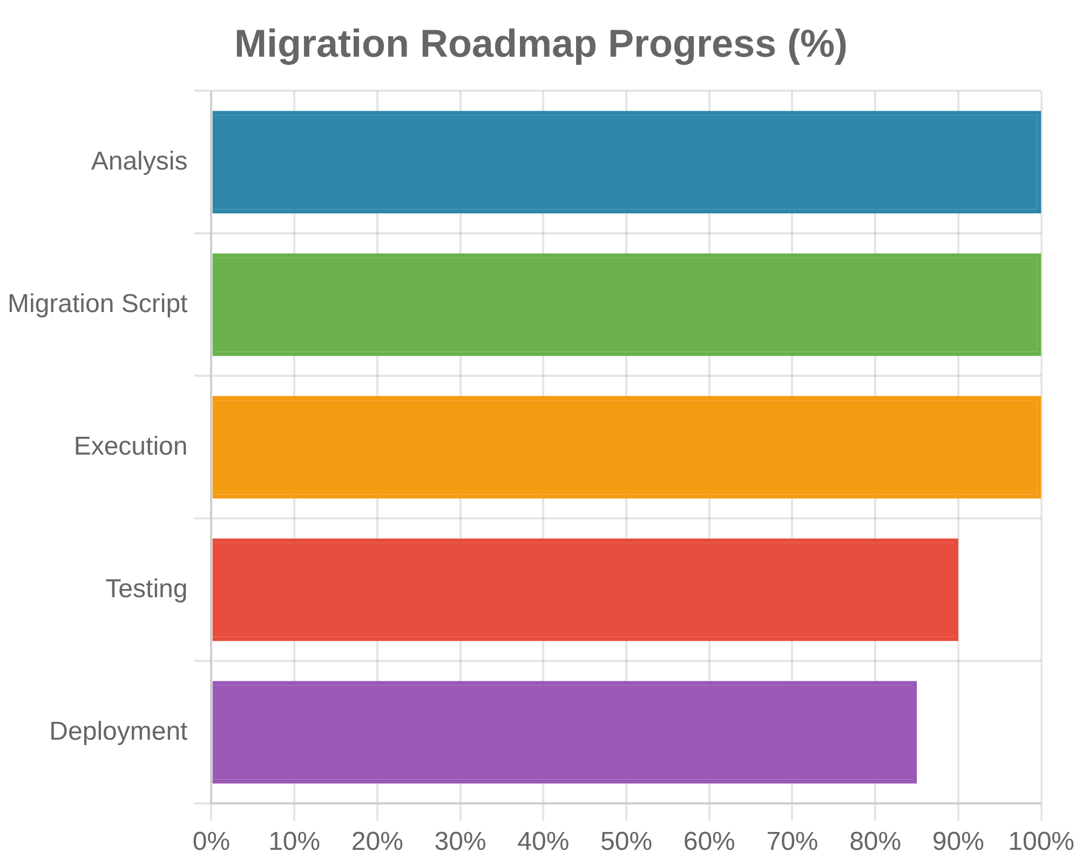



Migration Journey Overview
Project Scope & Approach
Project Scope:
Migrate Mule ESB applications to Spring Boot
microservices
Migration Approach:
Automated PowerShell-based
transformation
Technical Implementation:
Component mapping with code
generation
Results & Benefits:
93% success rate with improved
maintainability

Slide 3


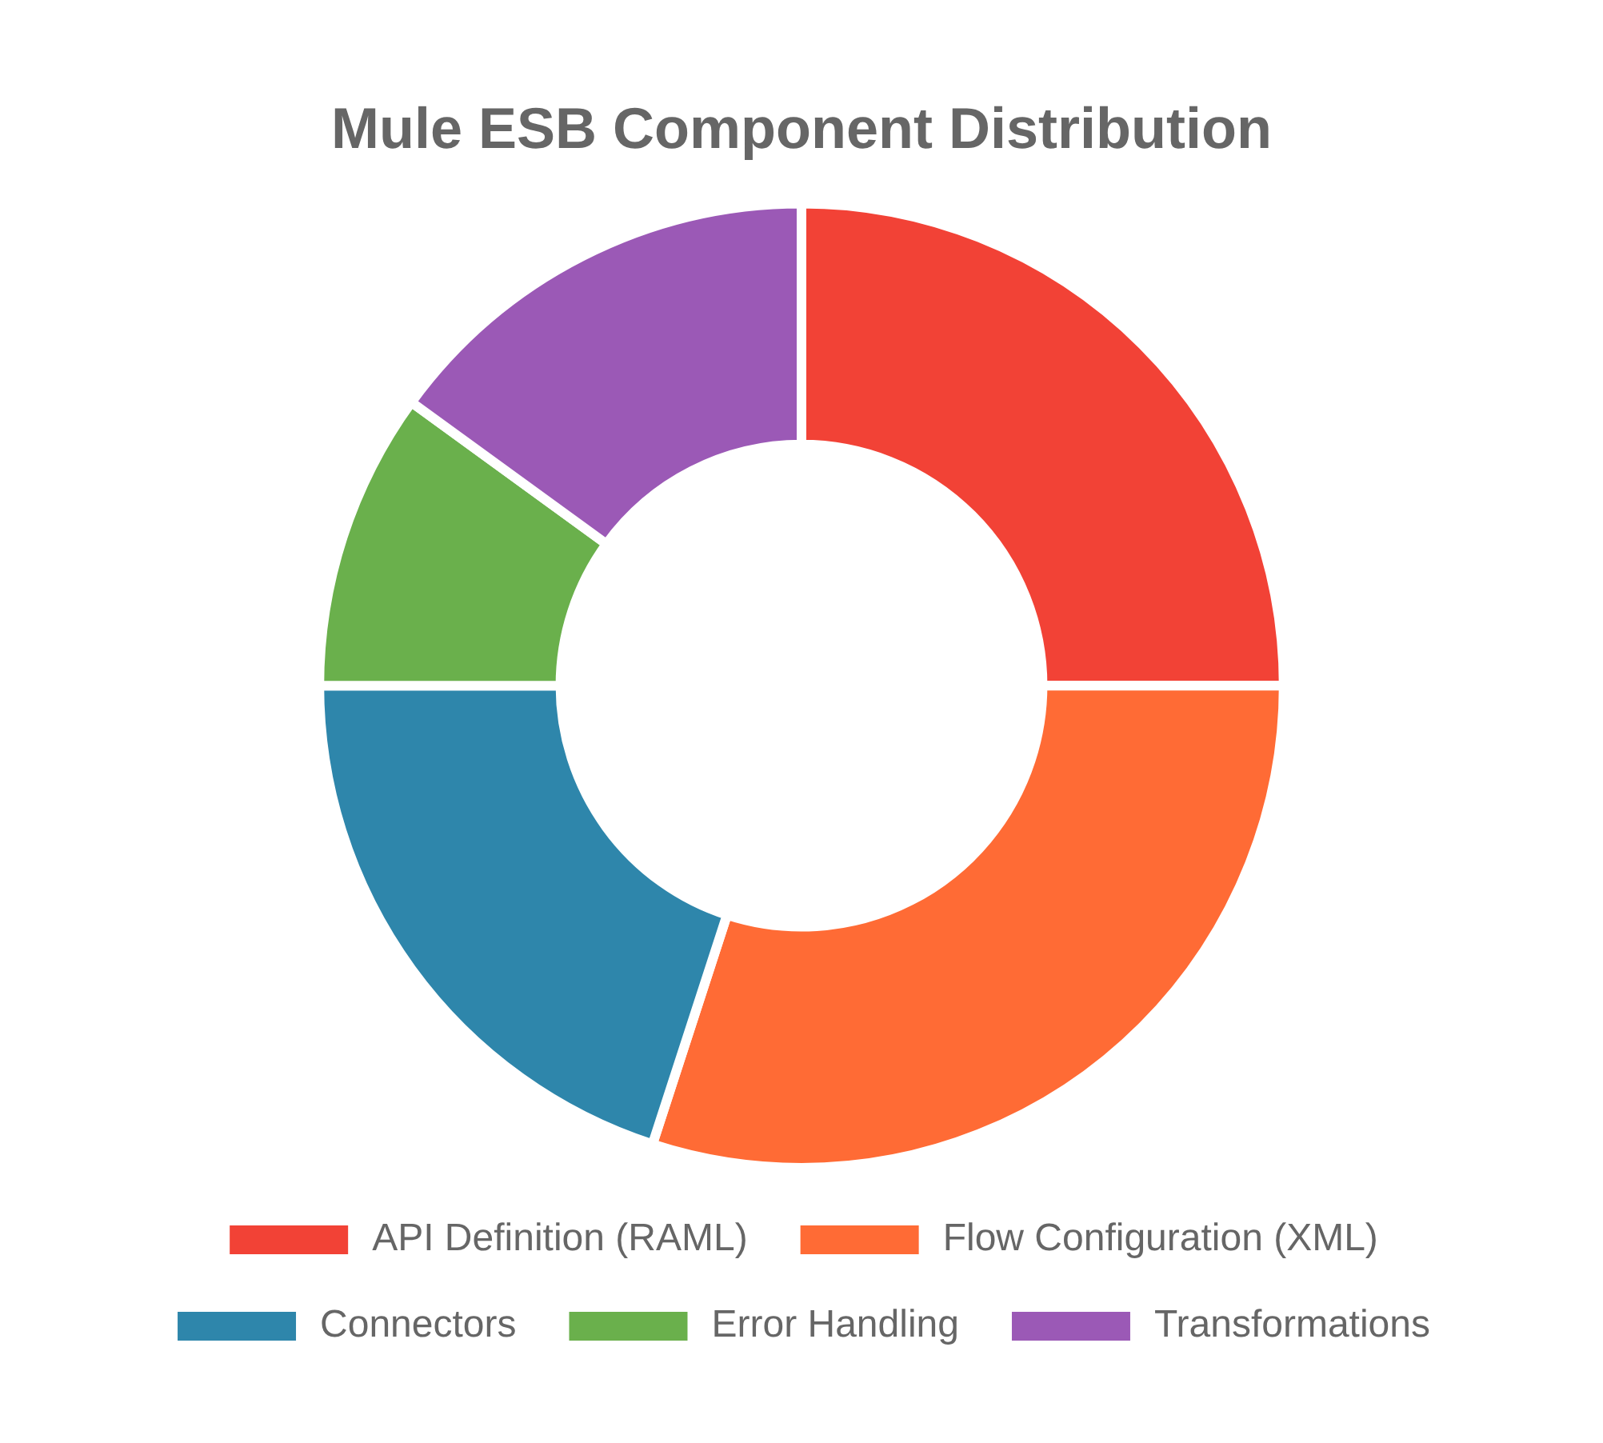




Source Architecture: Mule ESB
Key Architecture Components
RAML-First API Design
API definitions using RAML (RESTful API Modeling Language) with strong typing and documentation
XML-Based Flow Configuration
Business logic defined in XML files with visual flow representation in Anypoint Studio
Mule-Specific Connectors
Pre-built connectors for databases, messaging, and third-party systems
Message Transformation
DataWeave language for data mapping and transformation between formats

Slide 4

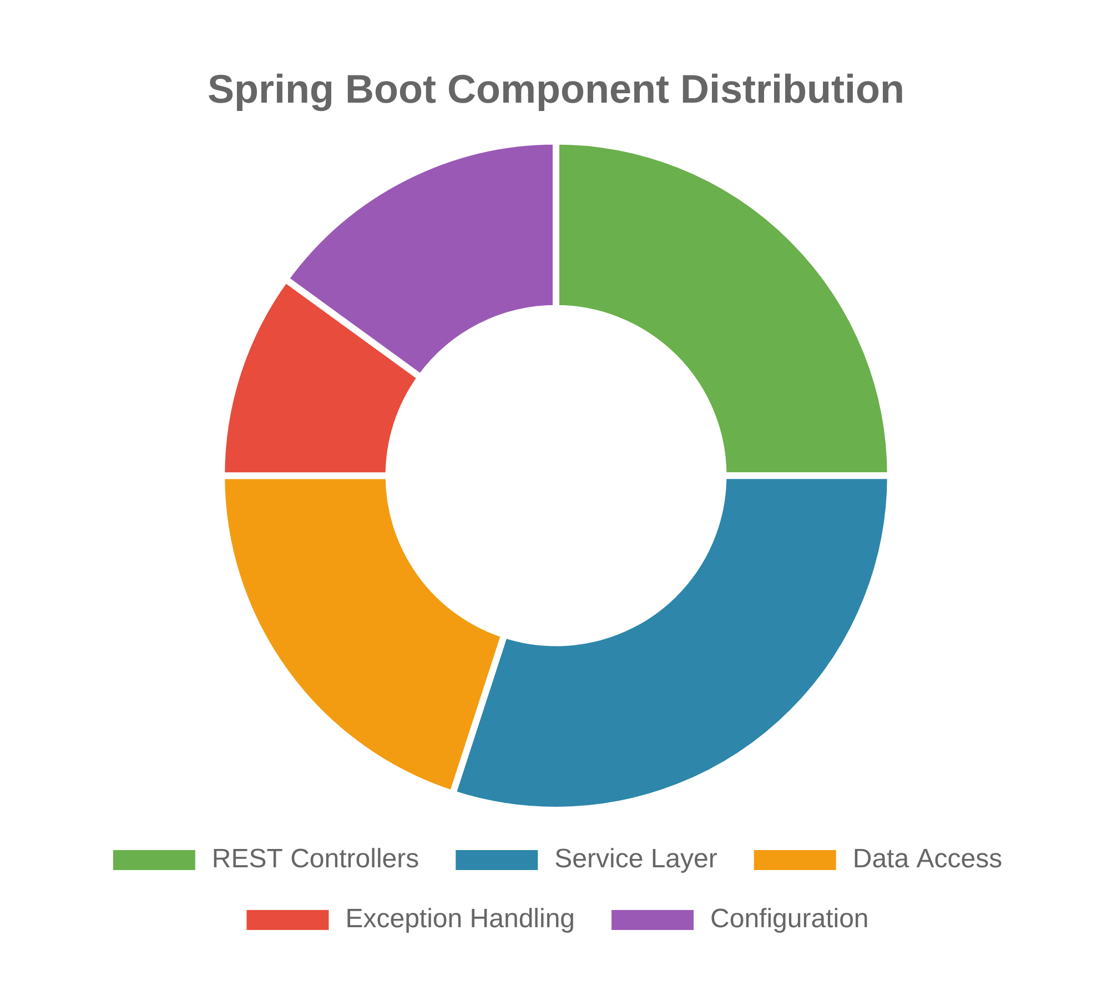



Target Architecture: Spring Boot
Key Architecture Components
Annotation-Based Configuration
Java annotations for defining controllers, services, and configuration
Java-Based Business Logic
Standard Java classes with Spring framework integration
Spring Data & JdbcTemplate
Simplified database access with SQL query execution
Exception Handling
Centralized error handling with @ControllerAdvice and @ExceptionHandler

Slide 5

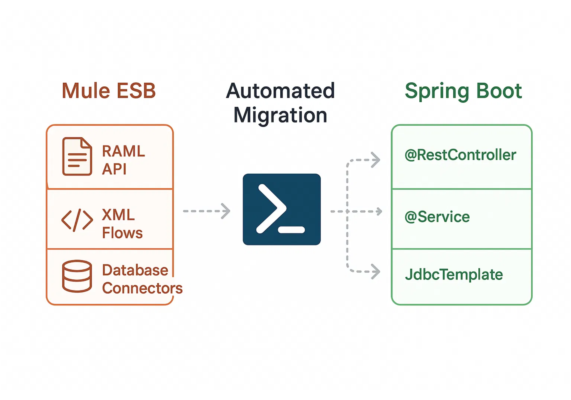

Automated Migration Strategy
Migration Approach
PowerShell Automation
Single script approach with run-generic-migration-smart.ps1 to handle any Mule project
Component Mapping Strategy
Direct mapping between Mule components and Spring Boot equivalents
Preservation of Functionality
Maintain all business logic and API contracts during migration
Modular Transformation
Separate scripts for RAML parsing, flow extraction, and project generation

Slide 6

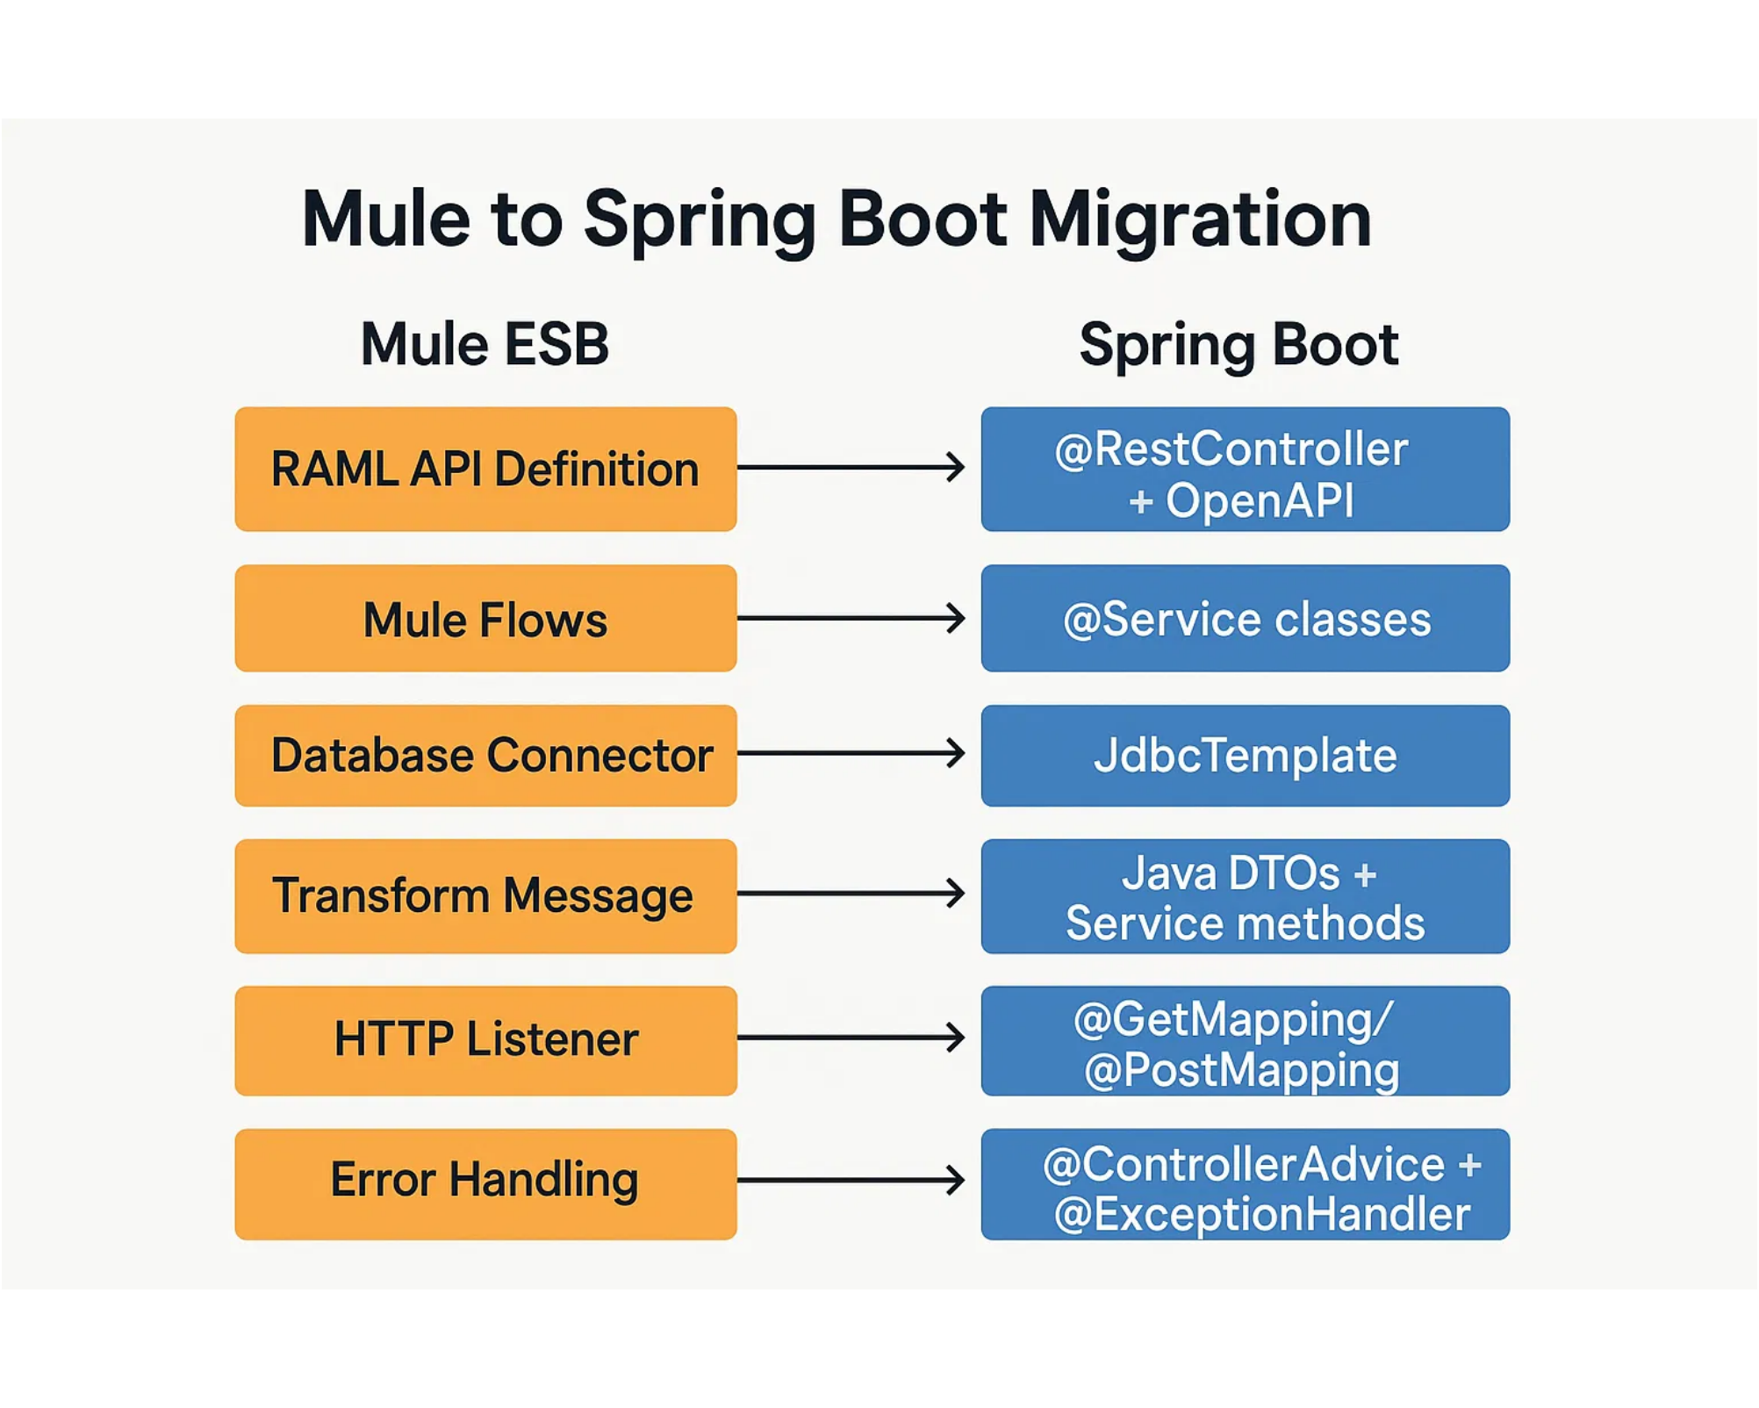
Mule to Spring Boot Component Mapping
Technical Component Mapping
Mule Component
Spring Boot Equivalent
RAML API Definition
@RestController + OpenAPI
Mule Flows
@Service classes
Database Connector
JdbcTemplate
Transform Message
Java DTOs + Service methods
HTTP Listener
@GetMapping, @PostMapping
Error Handling
@ControllerAdvice + @ExceptionHandler
The migration process automatically maps each Mule component to its Spring Boot equivalent, preserving functionality while modernizing the implementation approach.

Slide 7

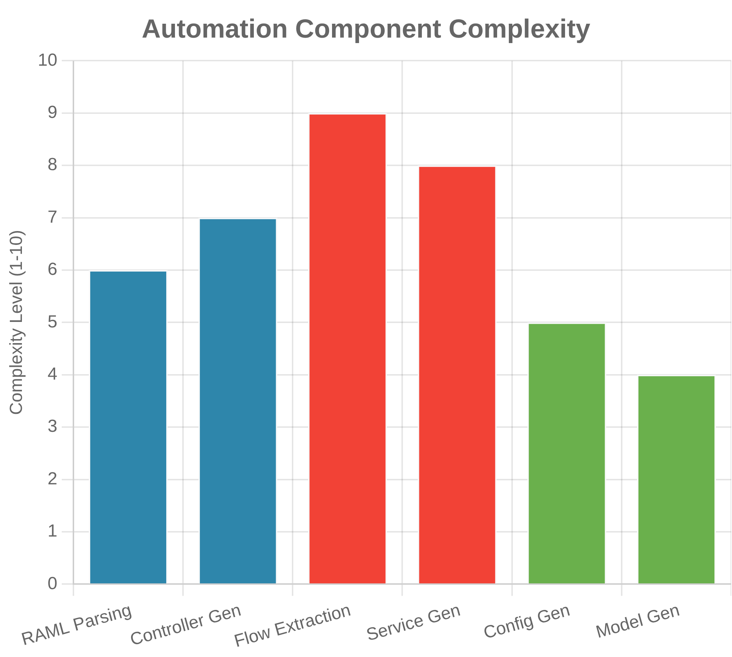
Migration Automation Process
PowerShell Automation Steps
1
Script Initialization
The main script
run-generic-migration-smart.ps1
accepts parameters for Mule project path, output path, and
package name
.\run-generic-migration-smart.ps1 -MuleProjectPath ".\mule-source" -OutputPath "employee-spring" -PackageName "com.company.employee"
2
RAML Parsing & Controller Generation
Extracts API definitions from RAML files and generates Spring REST controllers with proper annotations
3
Mule Flow Extraction
Analyzes XML flow files to extract business logic and database operations for conversion to Java services
4
Project Structure Generation
Creates complete Maven project structure with proper package hierarchy, configuration files, and dependencies

Slide 8

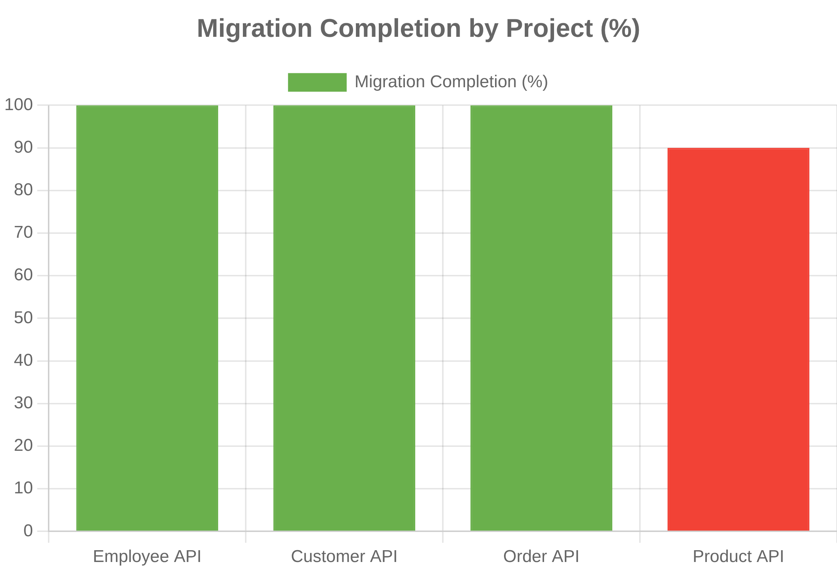


Migration Results & Success Metrics
Migration Success by Project
Key Achievements
Employee API
100% complete migration with all endpoints and business logic
Customer Management API
100% complete migration with CRUD operations
Order Processing API
100% complete migration with order management logic
Product Catalog API
90% complete - missing service layer due to XML parsing error
Automated Components Generated
Overall Success Rate
24
93%

Slide 9

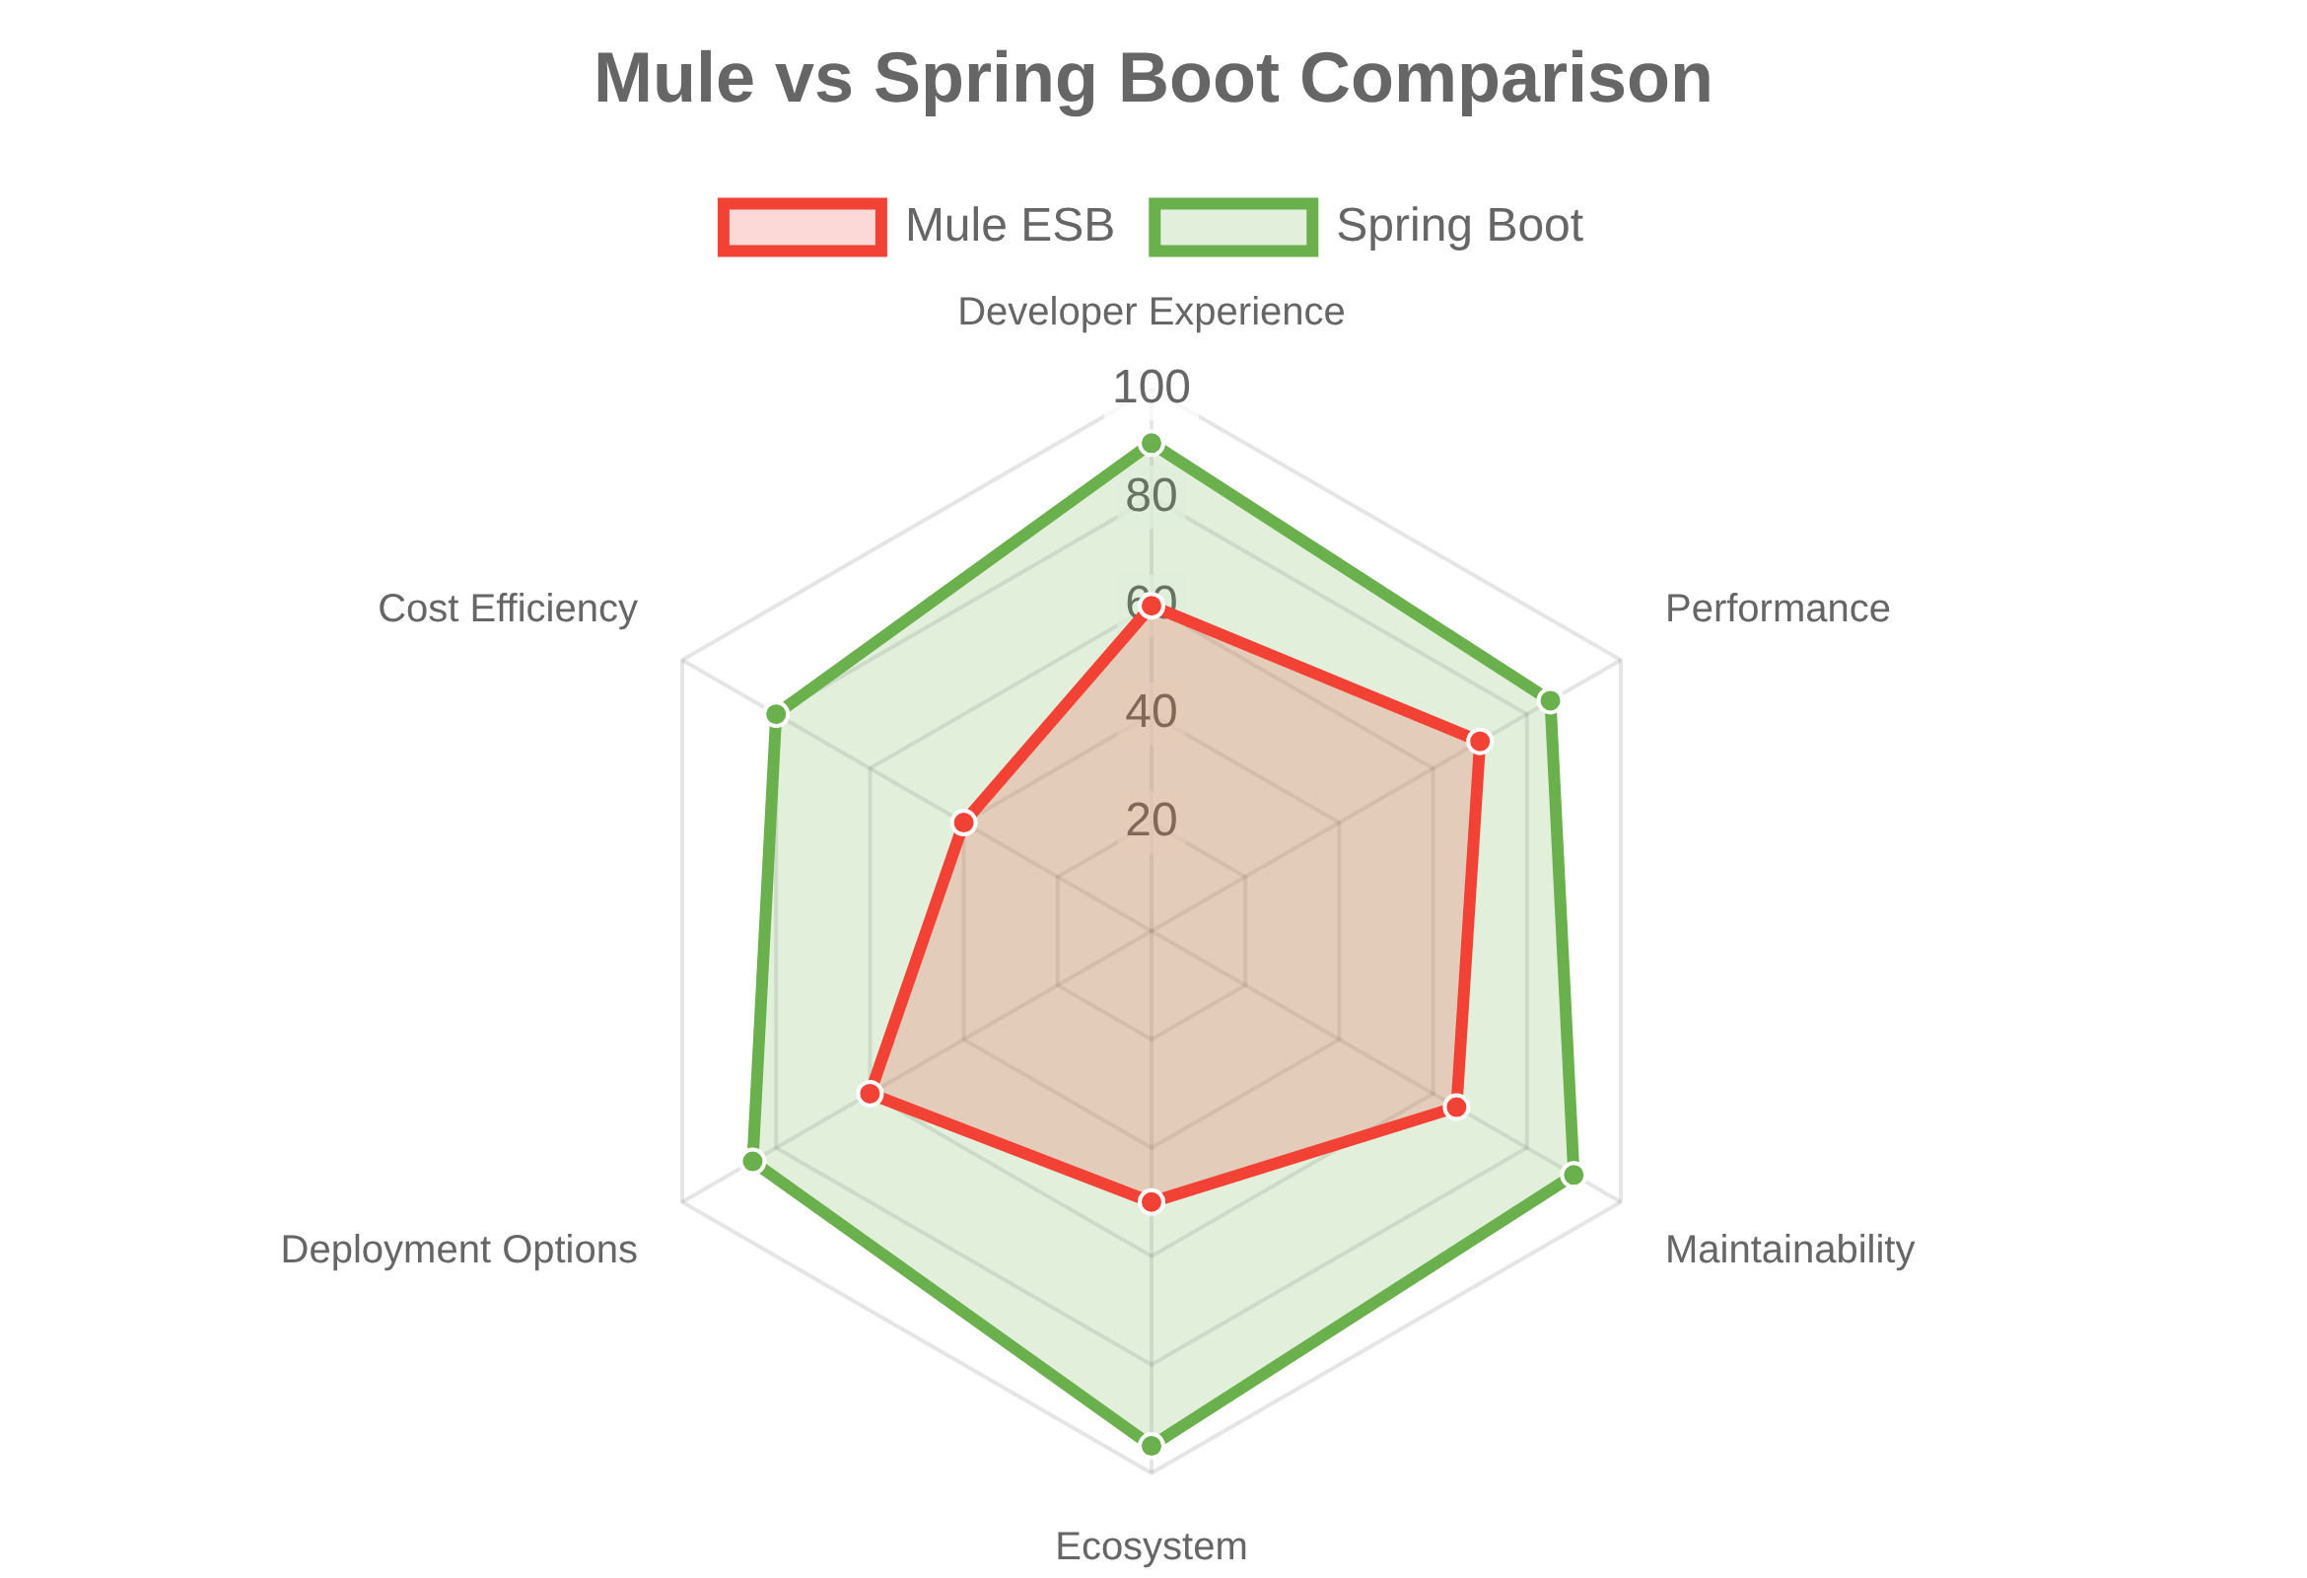




Migration Benefits & Value
Key Benefits
Improved Developer Experience
Standard Spring Boot architecture familiar to Java developers with better IDE support and debugging capabilities
Better Performance
Reduced runtime overhead, more efficient data handling, and faster startup times
Enhanced Maintainability
Clear separation of concerns with standard Java design patterns and easier testing
Spring Ecosystem Access
Access to vast Spring ecosystem of libraries, tools, and community support
Feature
Mule ESB
Spring Boot
Developer Availability
Limited
Abundant
Learning Curve
Steep
Moderate
Deployment Options
Limited
Flexible
Operational Cost
High
Lower

Slide 10


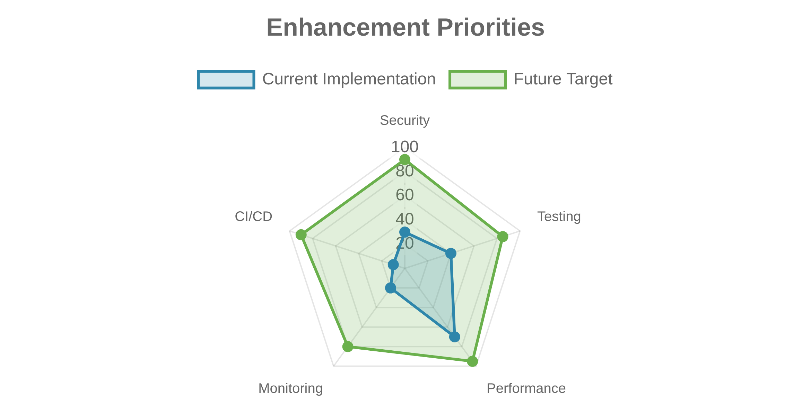

Conclusion & Future Roadmap
Migration Success Summary
Future Roadmap
Successful Automation
Demonstrated automated migration from Mule ESB to Spring Boot with 93% overall success rate
Technical Transformation
Converted XML-based flows to Java services while preserving business logic and API contracts
Reusable Approach
Created a generic script that can be applied to any Mule project with minimal configuration
Lessons Learned
1
Complete Product API service layer implementation
XML namespace handling and complex flow transformations require additional refinement
2
Add authentication and authorization support
3
Implement comprehensive test suite generation
4
Create CI/CD pipeline integration for automated deployment

